Slide 1
Lecture
The Recording Process
2
L.O. 2-1: Accounts, debits, and credits
L.O. 2-2: The journal
L.O. 2-3: The ledger and posting
L.O. 2-4: The trial balance

Slide 2
Learning Objective 2-1
Accounts, Debits, and Credits

Slide 3
Outline
Debits and credits
Summary of debit/credit rules

Slide 4
Debits and Credits
Duality of Transactions
Duality or double-sides nature of all financial transactions.
Every transactions involve a flow of economic benefit from a source to a destination.

Slide 5
Debits and Credits
Double-entry system
Each transaction must affect two or more accounts to keep the basic accounting equation in balance.
Requires the destination economic benefits equal to the source economic benefits

Slide 6
Debits and Credits
An account is a place to record, sort and store all transactions that affect a related group of items.
Debits and Credits
Debit = “Left”; Destination
Credit = “Right”; Source

Slide 7
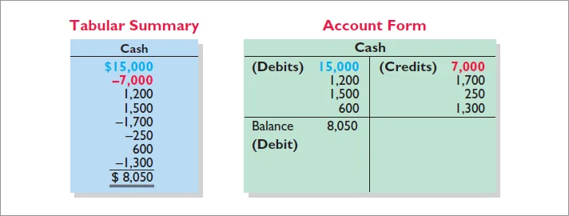
Debits and Credits
Tabular Analysis vs. T-account

Slide 8
Debits and Credits
If the sum of Debit entries are greater than the sum of Credit entries, the account will have a debit balance.
Transaction #1
$10,000
$3,000
Transaction #2
Transaction #3
8,000
Balance
$15,000

Slide 9
Debits and Credits
If the sum of Credit entries are greater than the sum of Debit entries, the account will have a credit balance.
Transaction #1
$10,000
$3,000
Transaction #2
8,000
Transaction #3
Balance
$1,000

Slide 10
Debits and Credits
Assets - Debits should exceed credits.
Liabilities – Credits should exceed debits.
Normal balance is on the increase side.

Slide 11
Debits and Credits
Owner’s investments and revenues increase stockholders’ equity (credit).
Dividends and expenses decrease stockholders’ equity (debit).

Slide 12

Debits and Credits
The purpose of earning revenues is to benefit the stockholders.
The effect of debits and credits on revenue accounts is the same as their effect on stockholders’ equity.
Expenses have the opposite effect: expenses decrease stockholders’ equity.

Slide 13
Debits and Credits
Normal Balance Debit
Normal Balance Credit

Slide 14
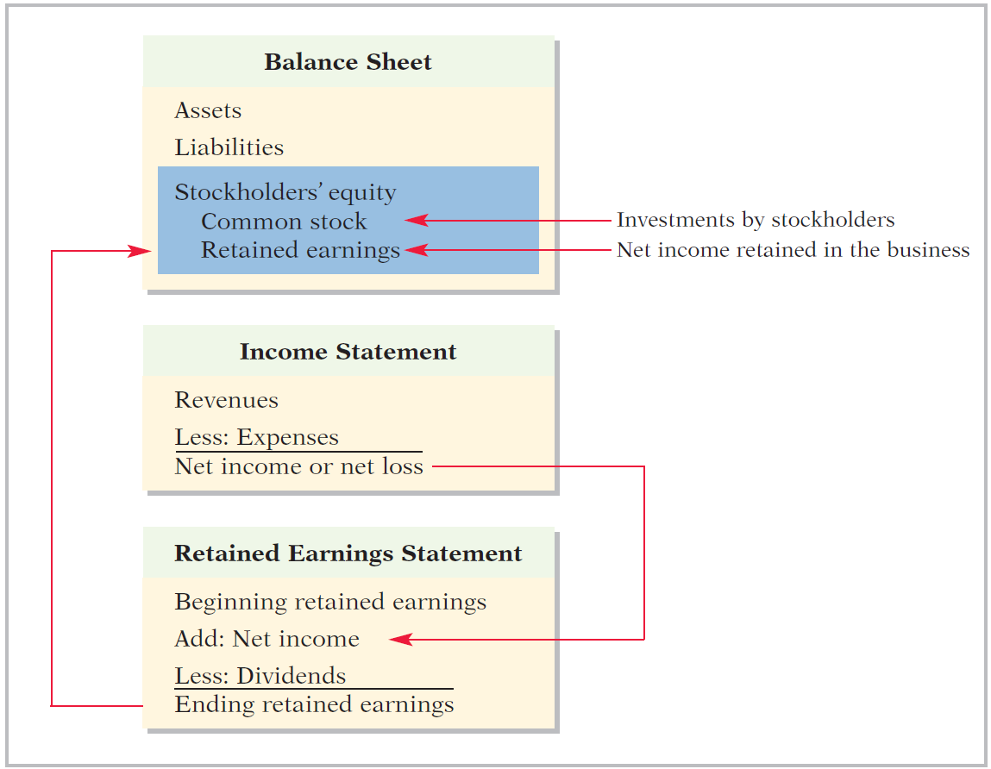
Stockholders’ Equity Relationships
3
1
2

Slide 15


Summary of Debit/Credit Rules
Balance Sheet Income Statement
Asset
Liability
+
-
=
Equity
Revenue
Expense
Debit
Credit

Slide 16
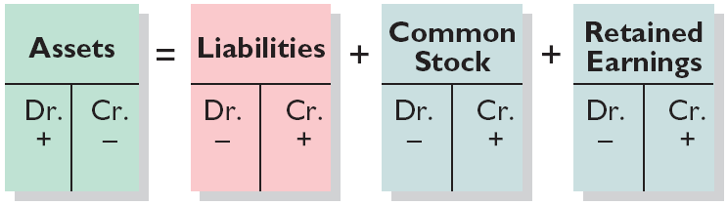
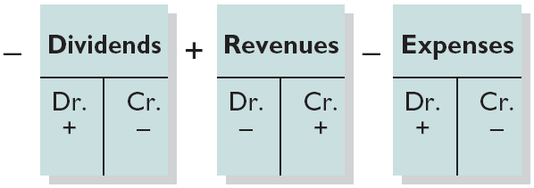
Summary of Debit/Credit Rules
Relationship among the assets, liabilities and stockholders’ equity of a business:
Basic Equation
Assets
=
Liabilities
+
Stockholders’ Equity
Expanded Equation
Debit/Credit Effects
The equation must be in balance after every transaction. Total Debits must equal total Credits.

Slide 17
Summary of Debit/Credit Rules
Question
Accounts that normally have debit balances are:
assets, expenses, and revenues.
assets, expenses, and equity.
assets, liabilities, and dividends.
assets, dividends, and expenses.

Slide 18
Learning Objective 2-2
The Journal

Slide 19
Outline
The recording process
The journal
Journalizing

Slide 20
The Accounting Cycle
1. Analyze business transactions
9. Prepare a post-closing trial balance
2. Journalize the transactions
8. Journalize and post closing entries
3. Post to ledger accounts
7. Prepare financial statements
4. Prepare a trial balance
6. Prepare an adjusted trial balance
5. Journalize and post adjusting entries

Slide 21
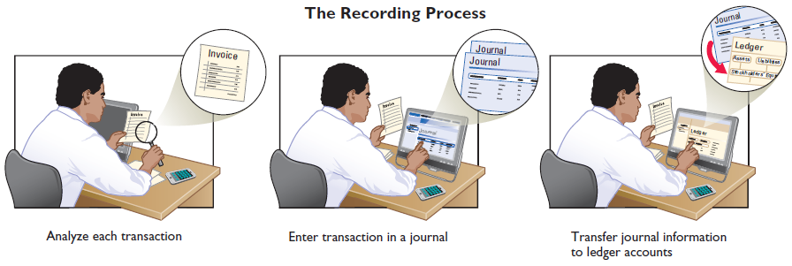
The Recording Process
Analyze each transaction
Enter transaction in a journal
Transfer journal information to ledger accounts
Business documents, such as a sales receipt, a check, or a bill, provide evidence of the transaction.

Slide 22
The Journal
Book of original entry.
Transactions recorded in chronological order.
Contributions to the recording process:
Discloses the complete effects of a transaction.
Provides a chronological record of transactions.
Helps to prevent or locate errors because the debit and credit amounts can be easily compared.

Slide 23
Journalizing – Simple Entry
JOURNALIZING – Entering transaction data in the journal.
Illustration: On September 1, stockholders invested $15,000 cash in the corporation in exchange for shares of stock, and Softbyte purchased computer equipment for $7,000 cash.
GENERAL JOURNAL
Sept. 1
Cash
15,000
Common Stock
15,000
Equipment
7,000
Cash
7,000

Slide 24
Journalizing – Compound Entry
Illustration: On July 1, Butler Company purchases a delivery truck costing $14,000. It pays $8,000 cash now and agrees to pay the remaining $6,000 on account.
GENERAL JOURNAL
July 1
Equipment
14,000
Cash
8,000
Accounts payable
6,000

Slide 25
DO IT!
Recording Business Activities
As president and sole stockholder, Kate Browne engaged in the following activities in establishing her salon, Hair It Is, Inc.
Opened a bank account in the name of Hair It Is, Inc. and deposited $20,000 of her own money in this account in exchange for shares of common stock.
Purchased equipment on account (to be paid in 30 days) for a total cost of $4,800.
Interviewed three persons for the position of hair stylist.
Prepare the entries to record the transactions.

Slide 26
DO IT!
Recording Business Activities
Prepare the entries to record the transactions.
Opened a bank account and deposited $20,000.
Purchased equipment on account (to be paid in 30 days) for a total cost of $4,800.
Interviewed three persons for the position of hair stylist.
Cash 20,000
Common Stock 20,000
Equipment 4,800
Accounts Payable 4,800
No entry

Slide 27
Learning Objective 2-3
Posting

Slide 28
Outline
The ledger
Posting
Chart of accounts
The recording process illustrated
Summary illustration of journalizing and posting

Slide 29
The Accounting Cycle
1. Analyze business transactions
9. Prepare a post-closing trial balance
2. Journalize the transactions
8. Journalize and post closing entries
3. Post to ledger accounts
7. Prepare financial statements
4. Prepare a trial balance
6. Prepare an adjusted trial balance
5. Journalize and post adjusting entries

Slide 30
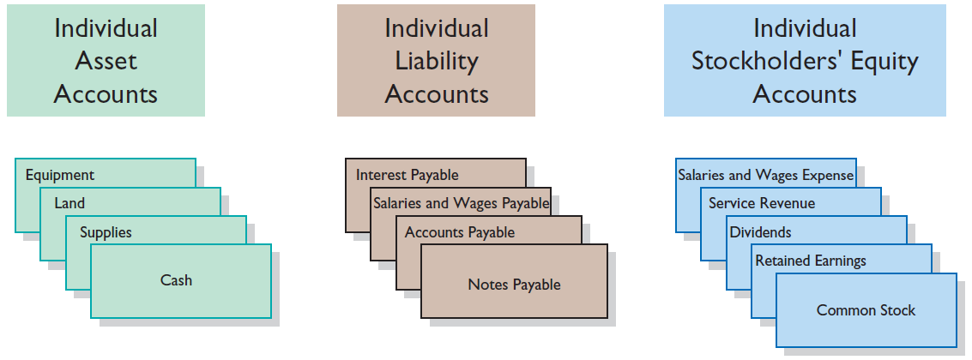
The Ledger
General Ledger contains all the asset, liability, and stockholders’ equity accounts.

Slide 31
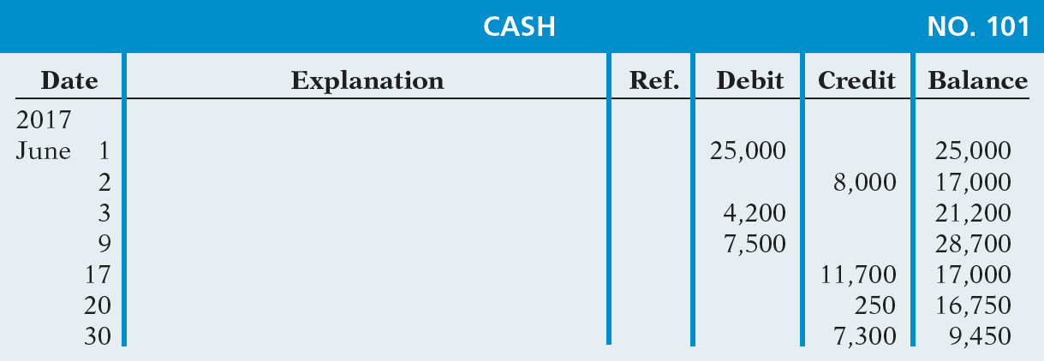
Standard Form of an Account
Three-column form of an account

Slide 32
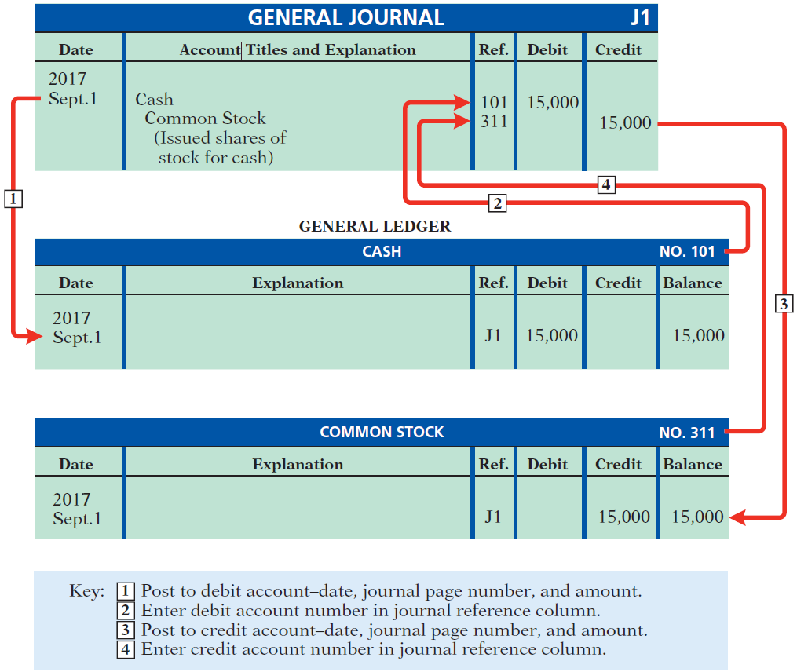
Posting
Transferring journal entries to the ledger accounts.

Slide 33
Posting
Question
Posting:
normally occurs before journalizing.
transfers ledger transaction data to the journal.
is an optional step in the recording process.
transfers journal entries to ledger accounts.

Slide 34
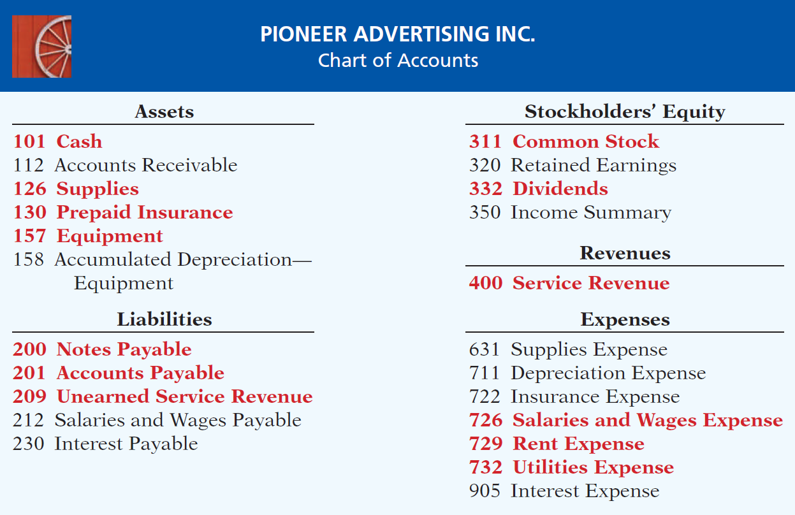
Chart of Accounts

Slide 35
The Recording Process Illustrated
Follow these steps:
1. Determine what type of account is involved.
2. Determine what items increased or decreased and by how much.
3. Translate the increases and decreases into debits and credits.

Slide 36
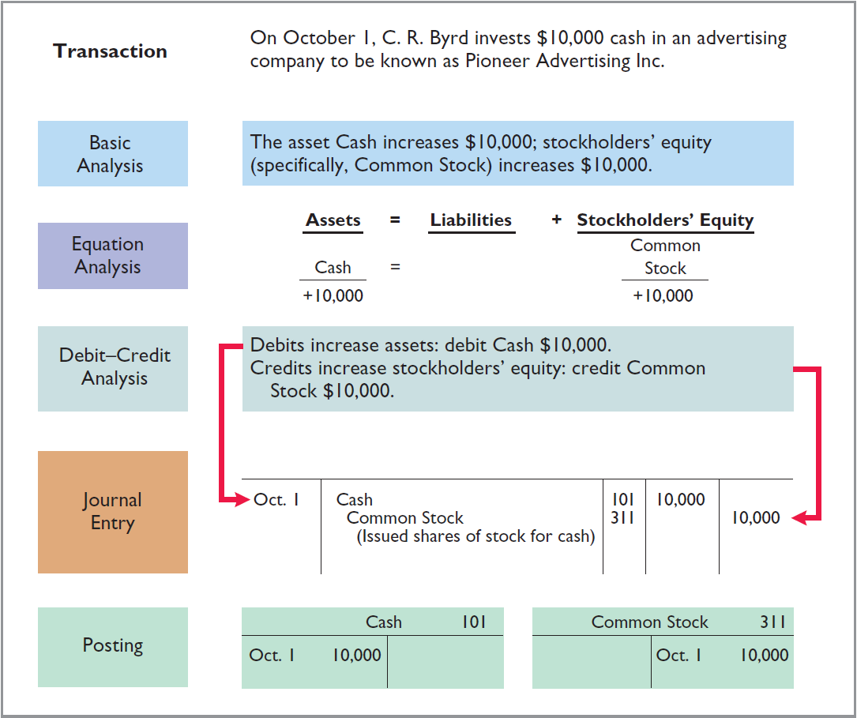

Slide 37
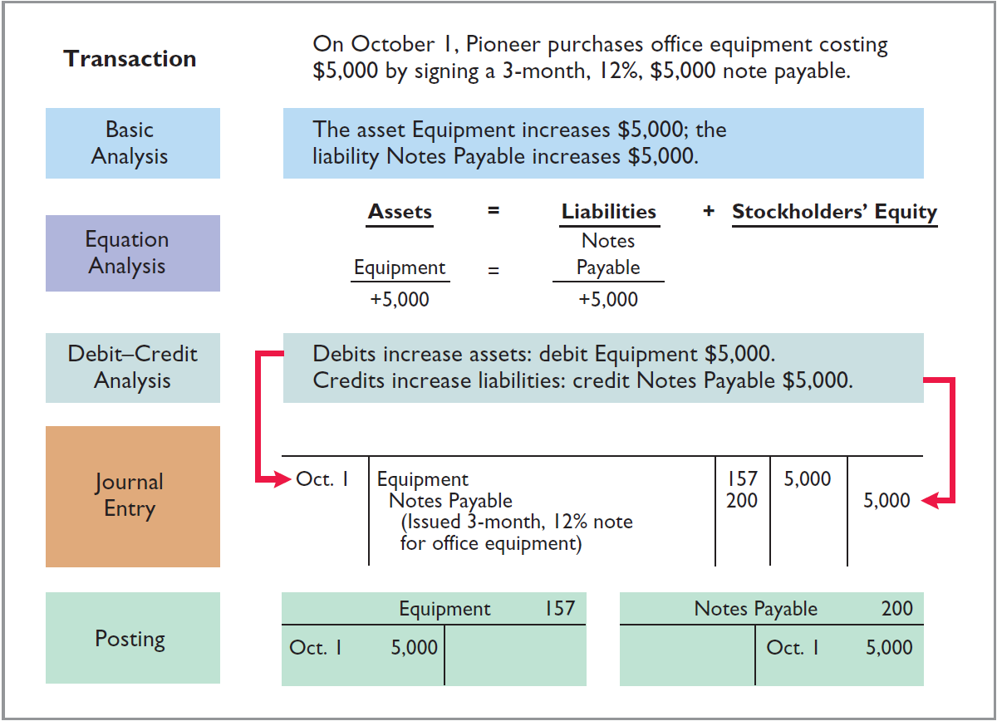

Slide 38
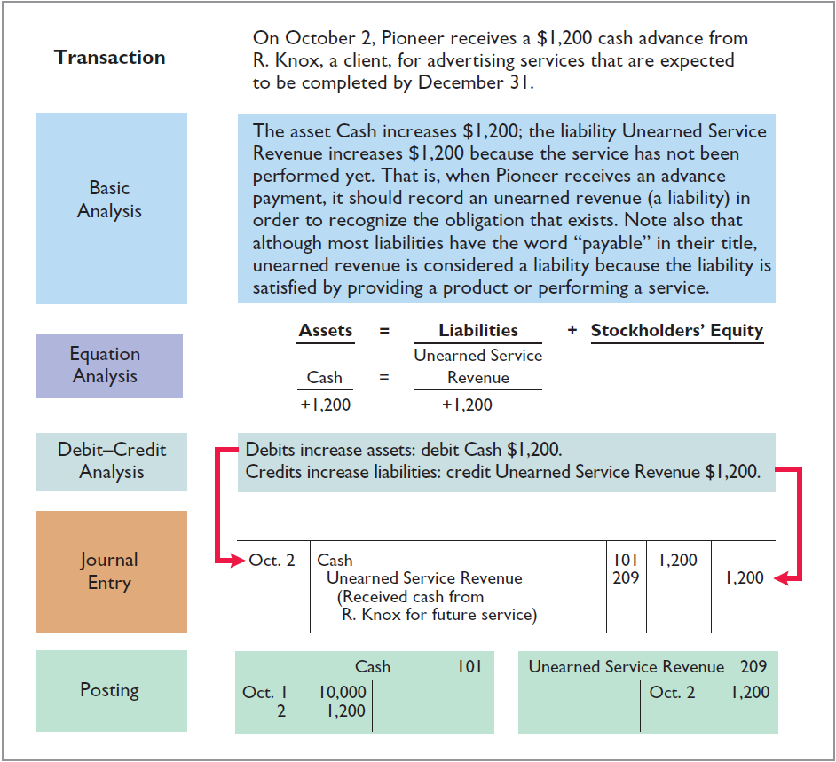

Slide 39
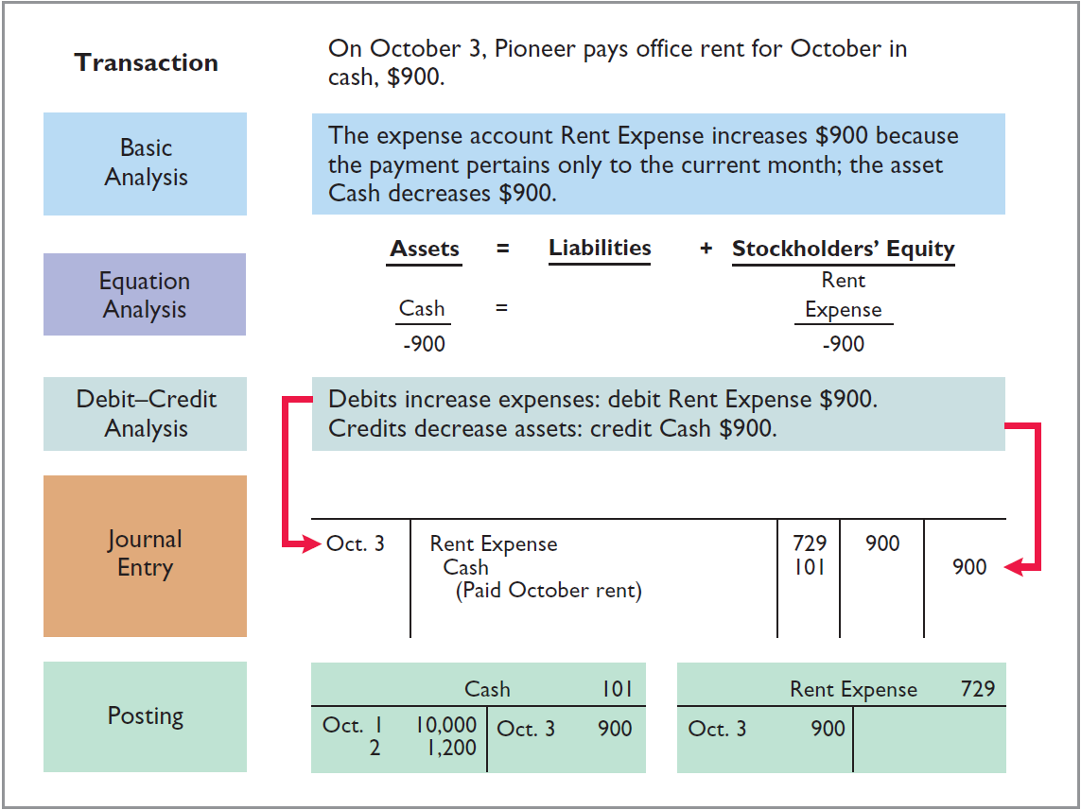

Slide 40
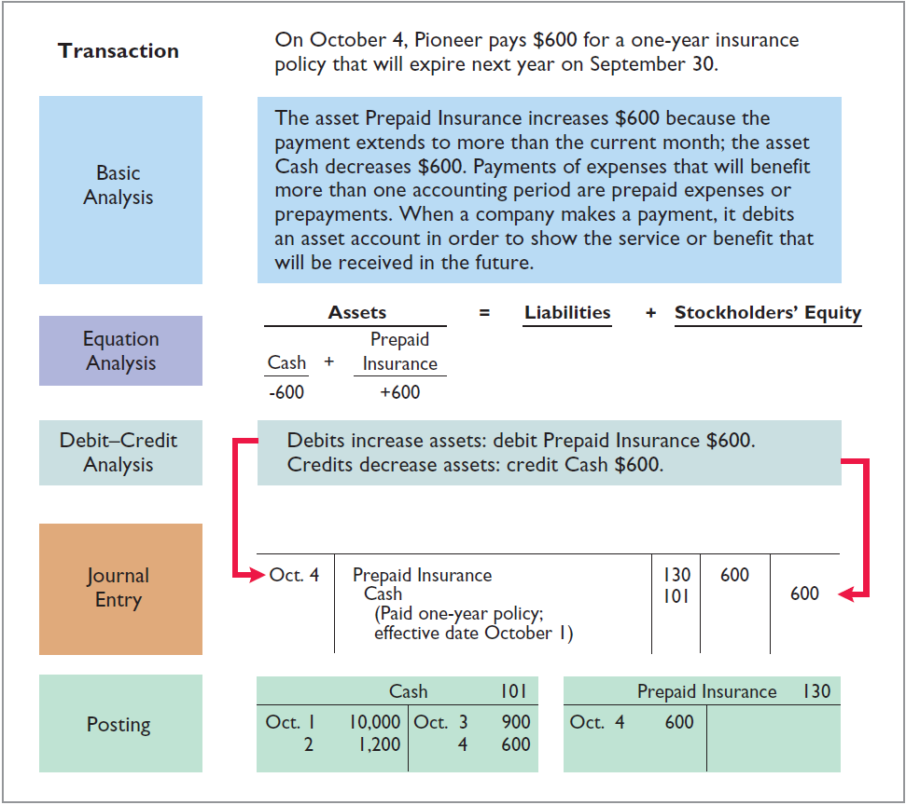

Slide 41
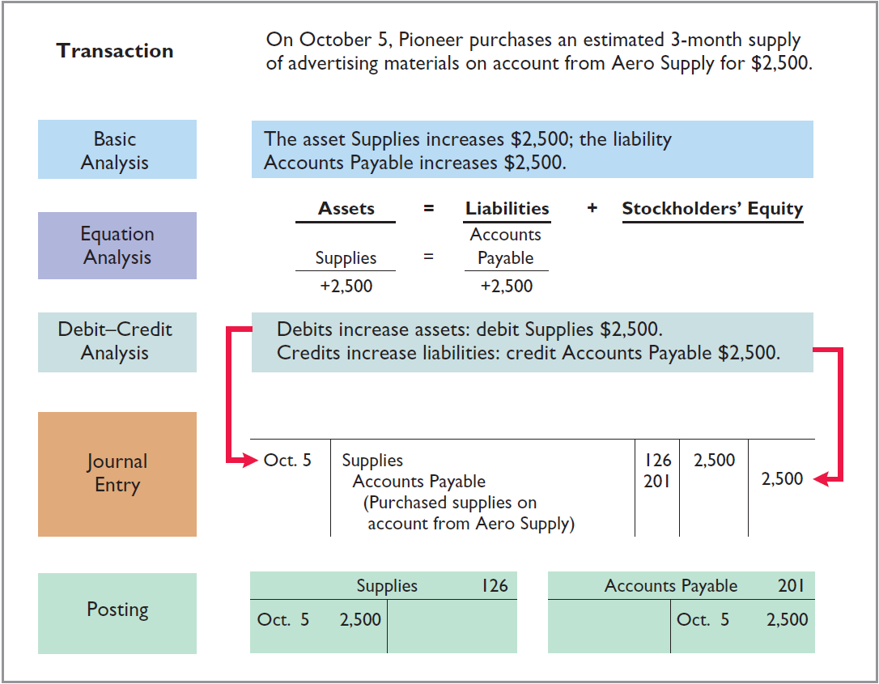

Slide 42
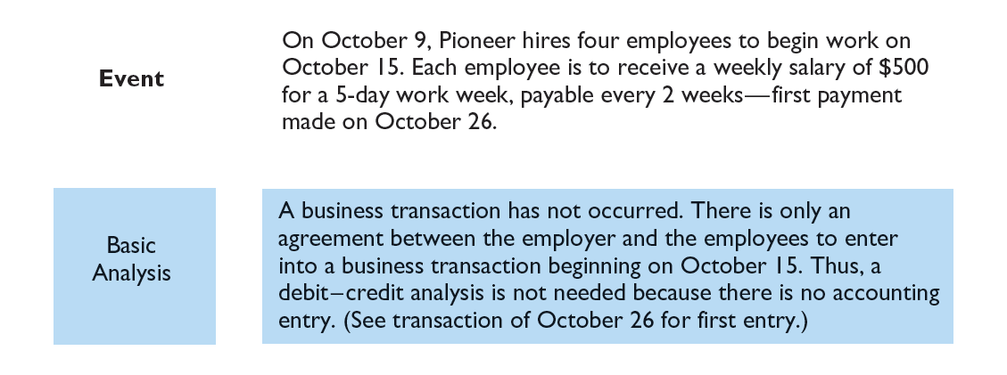

Slide 43
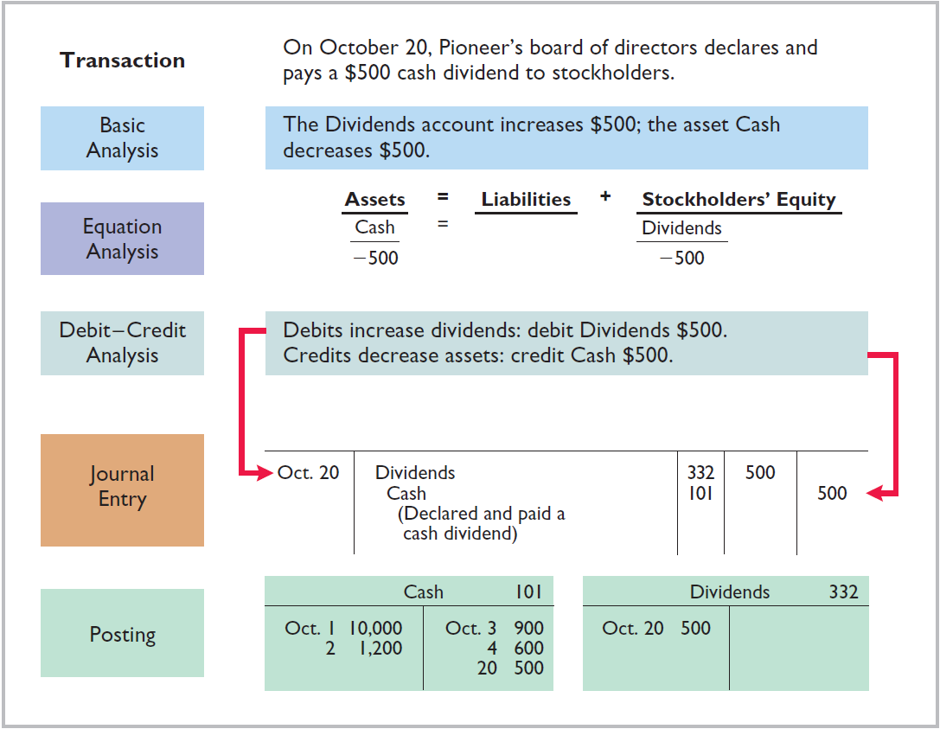

Slide 44
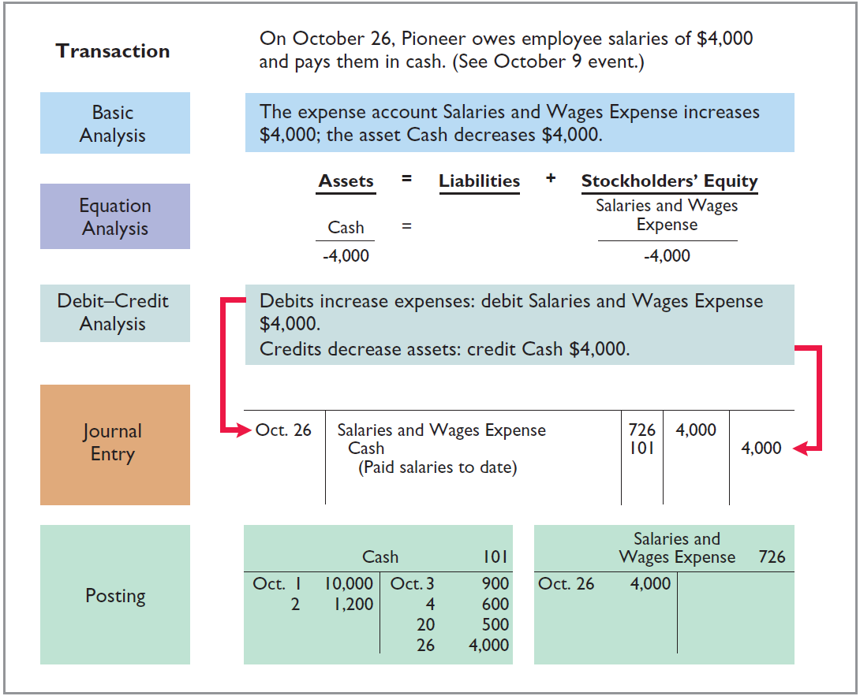

Slide 45
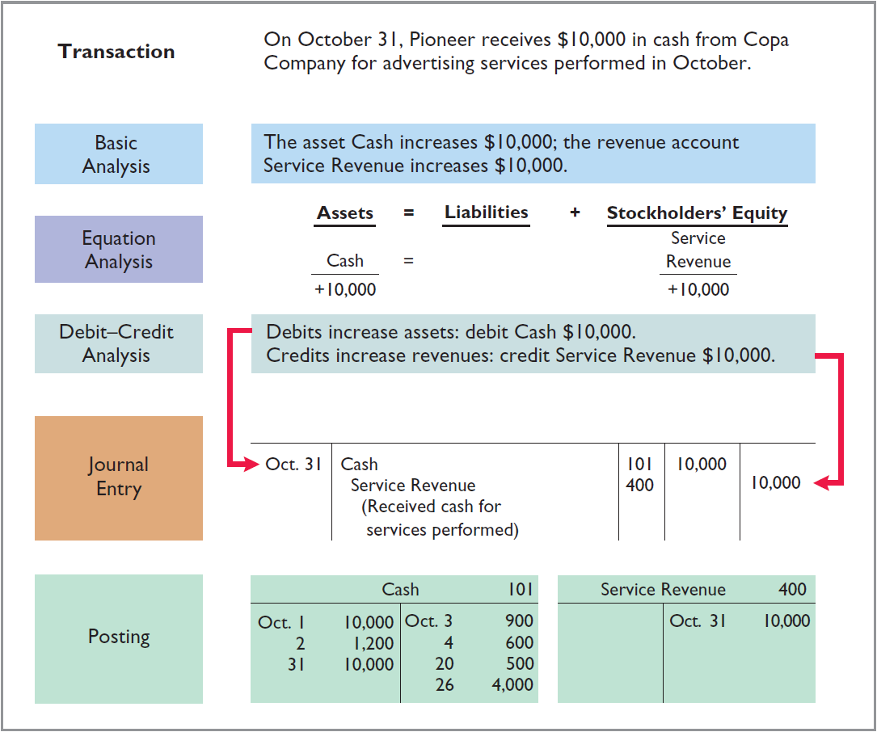

Slide 46
Learning Objective 2-4
The Trial Balance

Slide 47
Outline
The trial balance
Limitations of a trial balance

Slide 48
The Accounting Cycle
1. Analyze business transactions
9. Prepare a post-closing trial balance
2. Journalize the transactions
8. Journalize and post closing entries
3. Post to ledger accounts
7. Prepare financial statements
4. Prepare a trial balance
6. Prepare an adjusted trial balance
5. Journalize and post adjusting entries

Slide 49
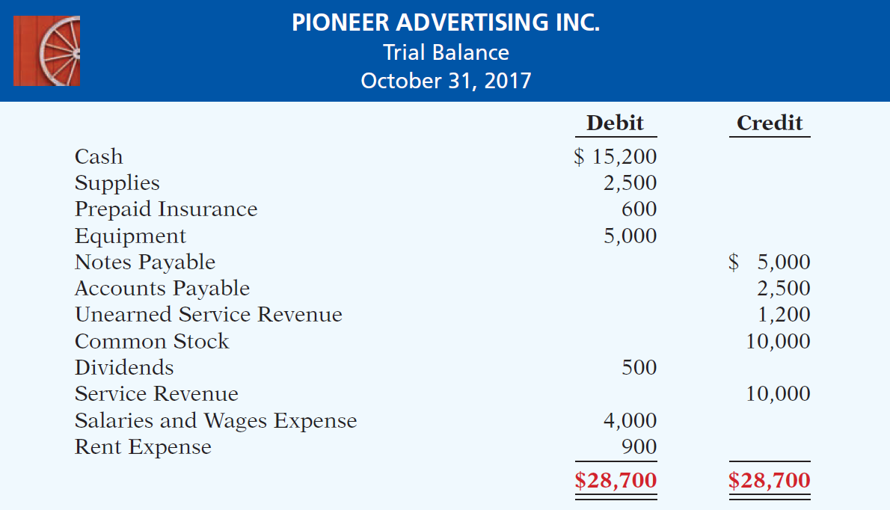
The Trial Balance
The trial balance is a list of accounts and their balances at any given time

Slide 50
Limitations of a Trial Balance
Trial balance may balance even when:
A transaction is not journalized.
A correct journal entry is not posted.
A journal entry is posted twice.
Incorrect accounts are used in journalizing or posting.
Offsetting errors are made in recording the amount of a transaction.

Slide 51
Trial Balance
Question
A trial balance will not balance if:
a correct journal entry is posted twice.
the purchase of supplies on account is debited to Supplies and credited to Cash.
a $100 cash drawing by the owner is debited to Owner’s Drawing for $1,000 and credited to Cash for $100.
a $450 payment on account is debited to Accounts Payable for $45 and credited to Cash for $45.

Slide 52
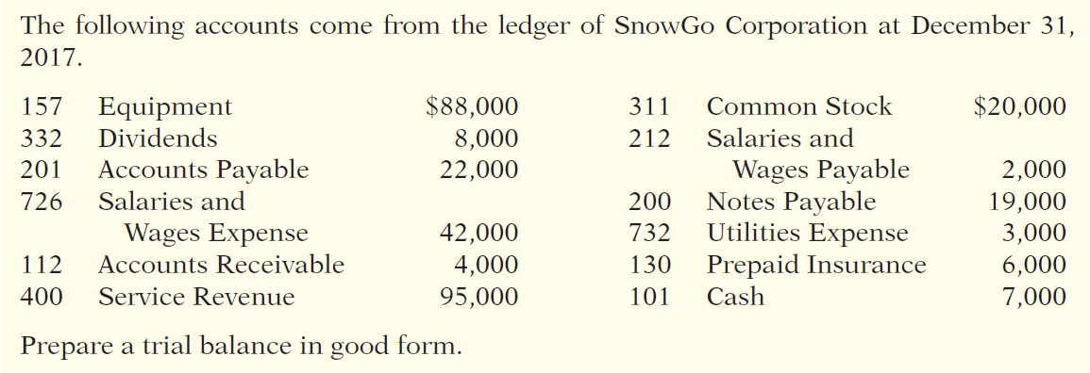
DO IT!
Trial Balance

Slide 53
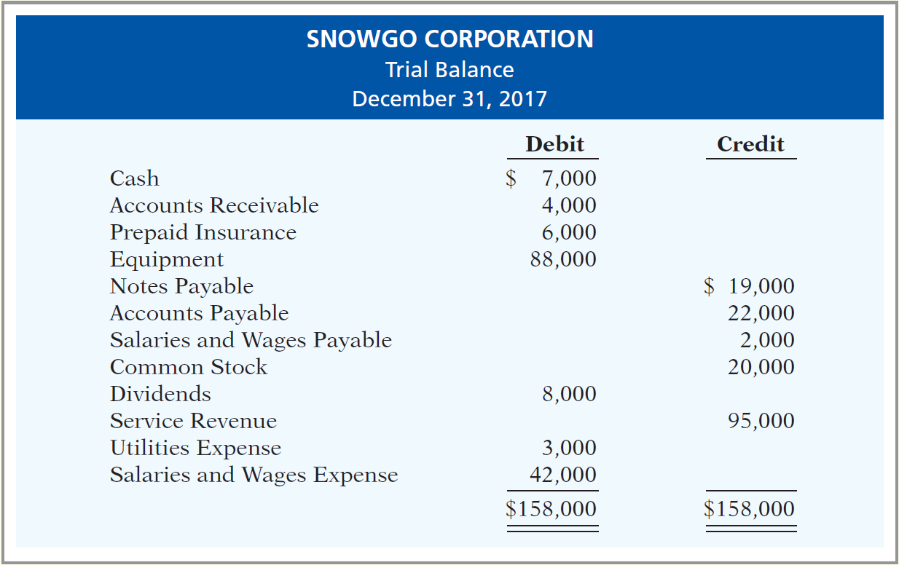
DO IT!
Trial Balance

